Slide 1

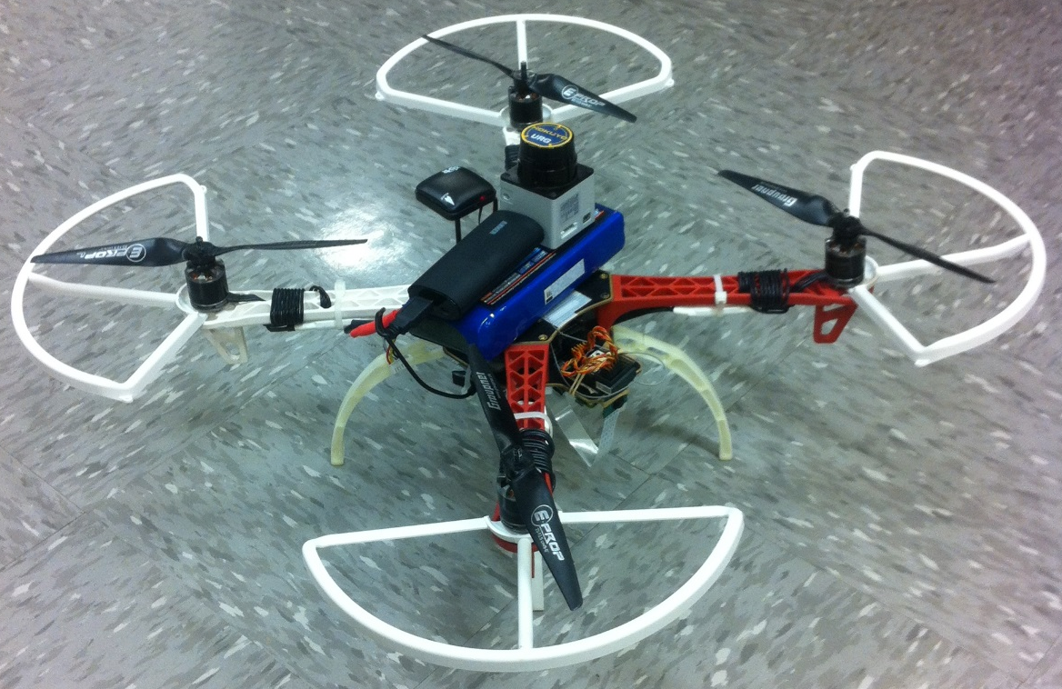

Autonomous UAV Final Presentation 5/11/2015
Dayton Savage
Bradford Stricklin
Michael Kowpak
Nathan Kocmoud
Adway Dogra
Dennis Moore
Allison Badgett
Jui Yen Chua
Fuhua Song
Spencer Davis

Slide 2
Project Specifications
Assumptions
Small children and infants do not need to be counted
All potential doors are already open
The flight will be in a commercial or industrial setting
People could be moving while the UAV is operating
No unusually large rooms
Autonomously navigate a building
Follow a mission planning algorithm
Count people in the building without double counting

Slide 3


All Team Tasks
Basics Completed:
Some Testing:
Fully Completed:
Identify Mapping Area
ROS Mapping
Wireless Communication
APM Calibration
Movement of UAV
A* Path Planner
Identify People
Enumeration Search Algorithm
Enumeration Tracking Algorithm
Camera Functions
Ultrasonic Wall Adder
SLAM
Follow A* Path
Height Reader/Adjuster
Power Management
Integration of Systems!

Slide 4
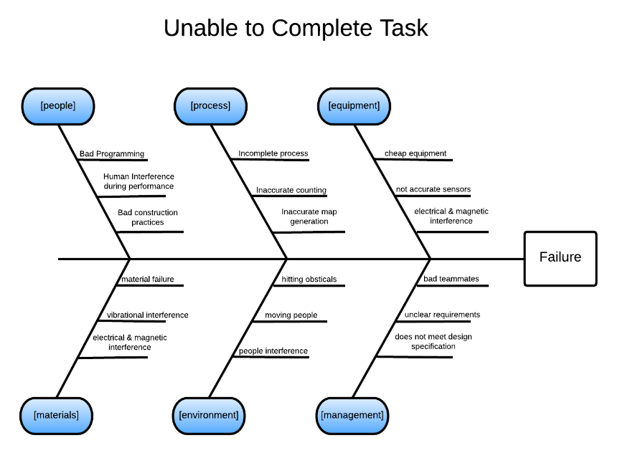
Failure Detail-
Possible:
Unexpected:
Very Unlikely:

Slide 5
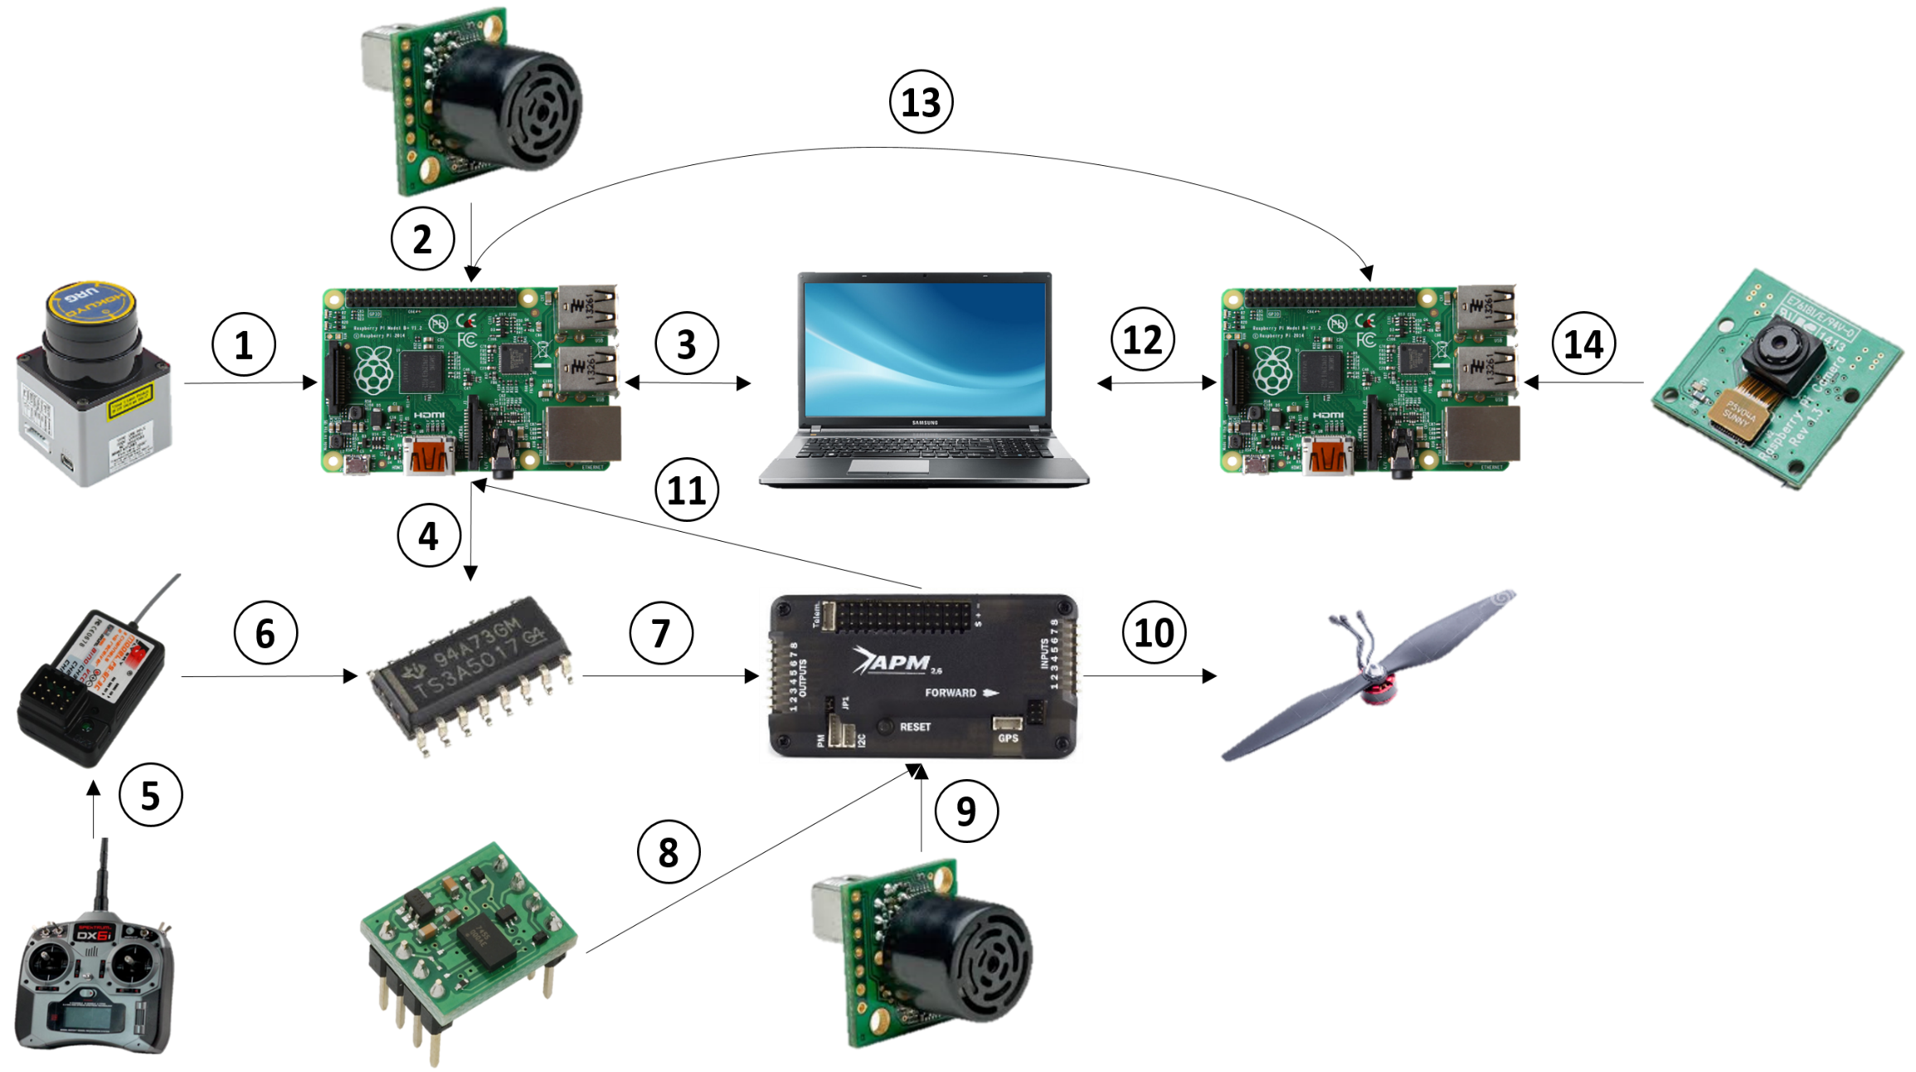
Data Flow Diagram
13. The navigation Pi and enumeration Pi are connected to one another to allow two-way communication
a. The enumeration Pi is fed data on the location of the UAV from the navigation Pi
b. The enumeration Pi then tells the navigation Pi where the UAV needs to move next (the navigation Pi will determine the specific motor commands itself)
12. When mapping is completed, the map is sent to the enumeration Pi to determine where the UAV will fly to allow counting of individuals.
a. The Pi also streams video from the camera to the base computer to be processed for counting and tracking of individuals
3. The Raspberry Pi and base computer communicate over Wi-Fi using TCP sockets
a. The Raspberry Pi sends it’s sensor data to the base computer which uses the 2.5D point cloud (generated from a combination of the distance data and accelerometer data) to create a 2D grid map
b. The base computer then determines where the UAV needs to move next by looking at the cells of the 2D grid (identified as open, obstacle, or unexplored) and sending the corresponding motor commands to the Pi
5. The RC controllers commands are sent to the receiver on the UAV
a. The RC controller has a switch that controls the input selector on the multiplexer
b. The RC controller also passes along motor controls from the user
1. The laser range scanner relays distance data to the Raspberry Pi
6. The receiver passes along the inputs from the RC to one of the input channels of the multiplexer
10. Motor commands are passed along from the multiplexer to the motors
4. The Pi passes the motor commands along to the multiplexer
14. The Pi camera module captures video and sends it to the Pi to be sent to the base computer for tracking and counting
11. Telemetry data from the accelerometer and ultrasonic height sensor are sent to the Pi so they can be sent to the base computer along with the LIDAR data
2. An ultrasonic sensor relays distance data to the Raspberry Pi (used for detecting
9. An ultrasonic sensor provides data on the height of the UAV
7. Based on the switch input from the RC controller, the multiplexer will pass along either the motor commands from the base computer or will allow a manual user override
8. The accelerometer (located inside the APM) provides telemetry data

Slide 6
Hardware

Slide 7
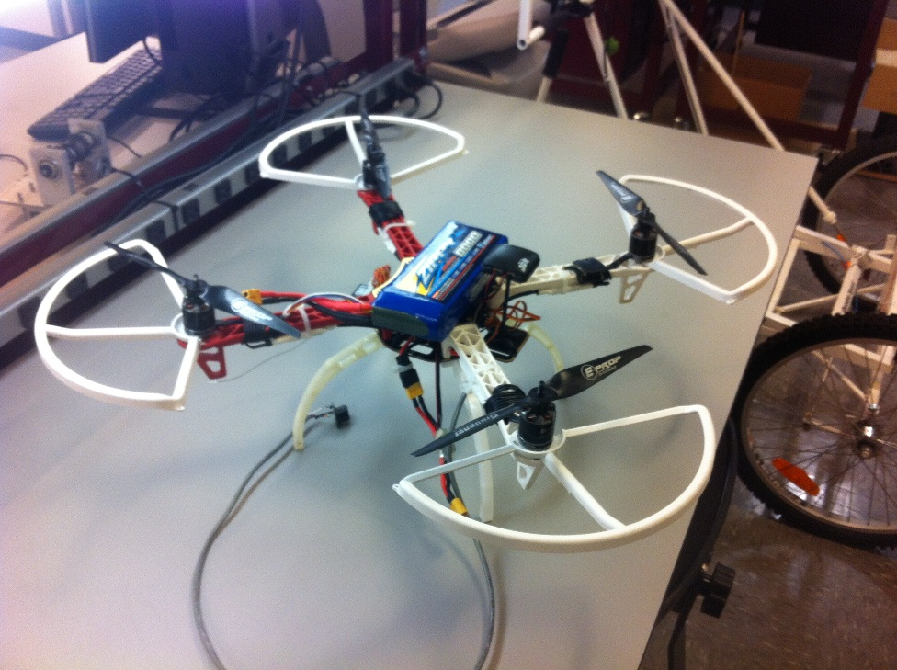
Spencer (Quadcopter Design)
Quadcopter
APM 2.6
Sonar Sensor
Rotor guards
14.8 V, 30 A battery

Slide 8
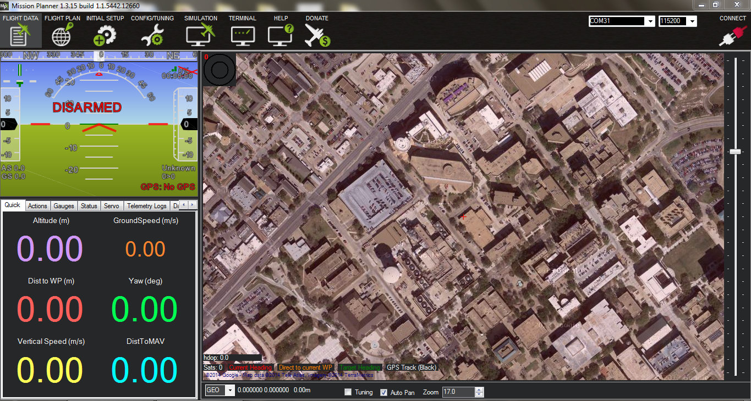
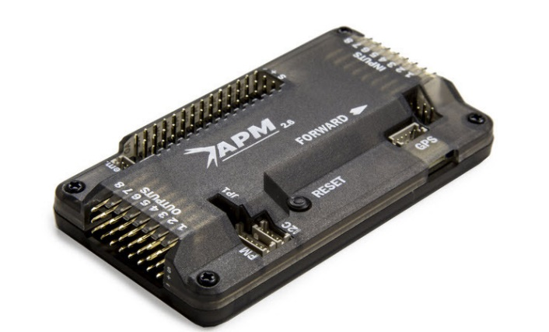
Mission Planner/APM 2.6 (Adway)
Successful outdoor flight
Configured PID values to increase stability
Fixed a problem with controls being inverted
Present stable AC firmware is Ardu-Copter 3.2
Using MaxBotix sonar for alt hold < 20ft

Slide 9
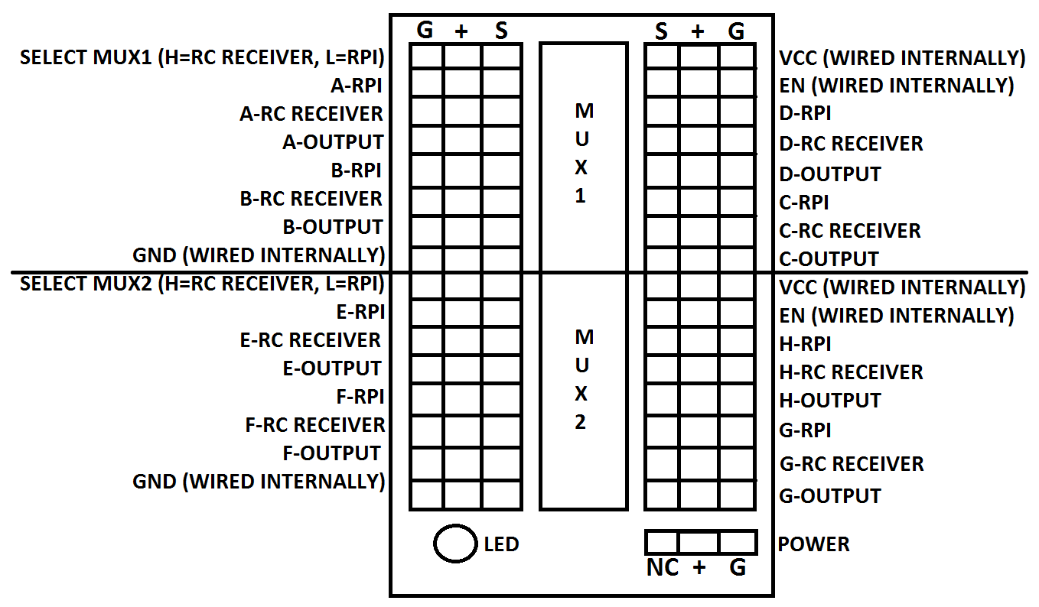
Fail-Safe Switch (Adway)
2-1 Multiplexer switch (SN74LS257BN)
Switch between receiver and RPi
Act as FS in case of RPi malfunction
Works well for analog signals at 50KHz
Breakout compatible with existing wiring

Slide 10
Autonomous Flight Alt Hold (Adway)
Barometer:
Widely used for outdoor altitude hold (alt>20ft)
Resolution of 10cm
HVAC vents make altitude hold unstable.
Ultrasonic sensor (Maxbotix)
Higher resolution (1cm) and is unaffected by pressure.
Sudden terrain changes should be accounted for.
Analog more vulnerable to noise due to the motors.
Implemented and tested on the UAV using AC 3.2

Slide 11
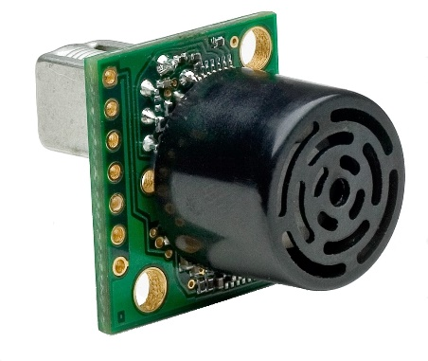
Sonar Altitude ( Spencer )
Maxbotix MB1242 Module
Connected to APM Aux pin 0
Mission Planner reads sensor data
Sends analog data to APM
When altitude hold is on APM keeps distance constant

Slide 12
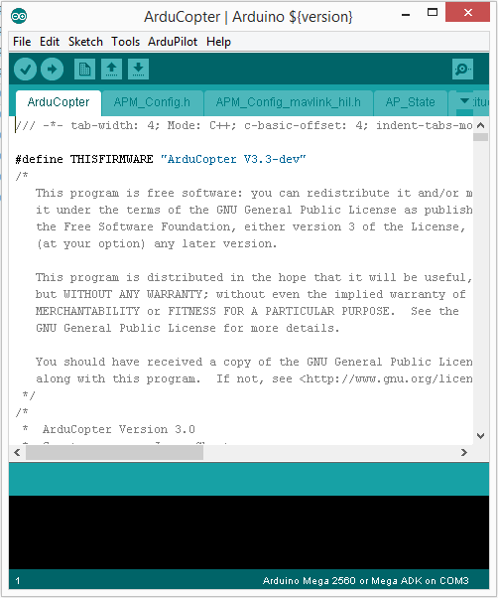
Arduino IDE (Michael)
Ardu-Copter firmware or
custom firmware
Very large, complex
Difficult to modify
Used to add libraries for sonar data
Upload through IDE, access
through Mission Planner

Slide 13
Arduino Custom Controller (Michael)
Custom Controller (Dr. Gareth Owen)
DIY flight controller programming
All information in one script
Easy to modify
Difficult to communicate with Pi
Does not use Ardu-Copter firmware
Provided information on flight controller workings

Slide 14
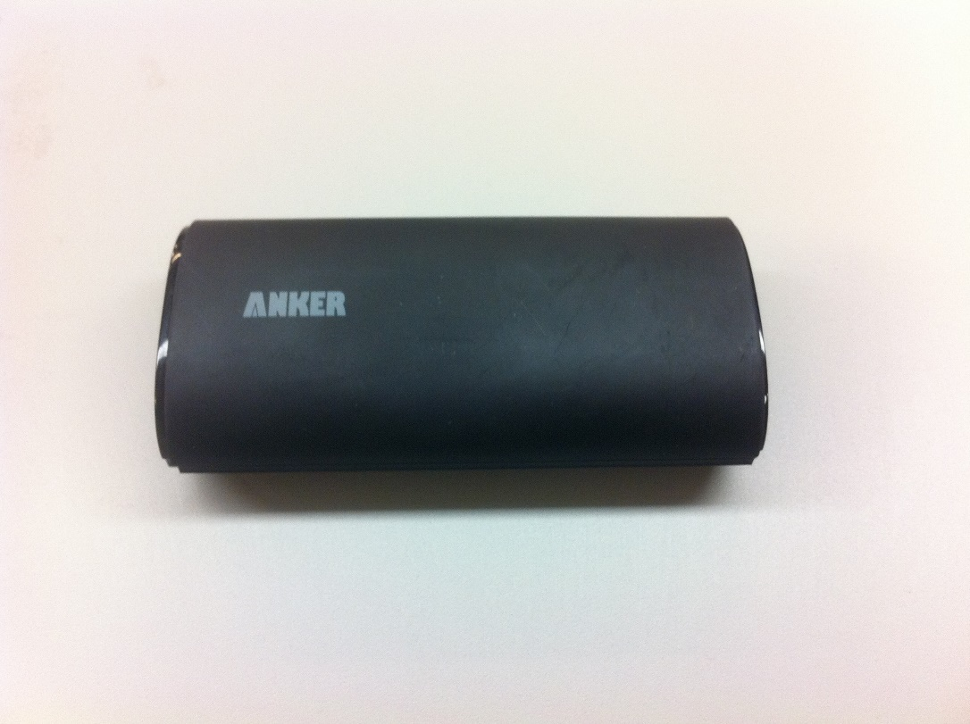
Power and Battery Options (Michael)
Must power
2 Raspberry Pi
Raspberry Pi camera
URG laser range finder
2 sonar sensors
All require 5 V and total of 1.3 A
External battery (Anker)
5 V, 2 A, 6000 mAh
Connected to sensors using USB connection

Slide 15
Hardware Conclusion
Developed a design to accomplish tasks
Lift load
Hold sensors
Stability during flight
Versatility (allow for changes)
Can be updated in the future
Continue working with Navigation team

Slide 16
Navigation

Slide 17
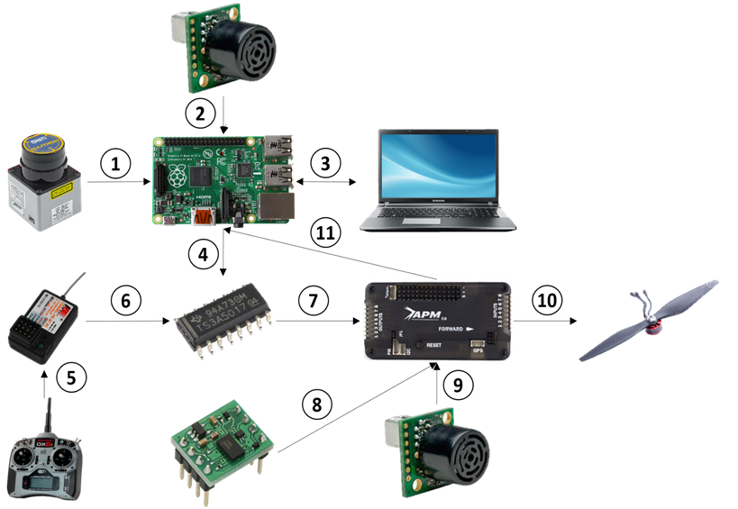
Communication
Established communication between the Pi, the APM, and the base computer using ROS
Set up base computer to receive telemetry data from the APM through the Pi
This includes accelerometer data and readings from the ultrasonic height sensor

Slide 18
Communication
Established proper talking and listening nodes to create ROS environment in which the Pi and base computer could communicate
Communication from APM to Pi done with modifications to HAL libraries
Communication other direction done using PWM signals

Slide 19
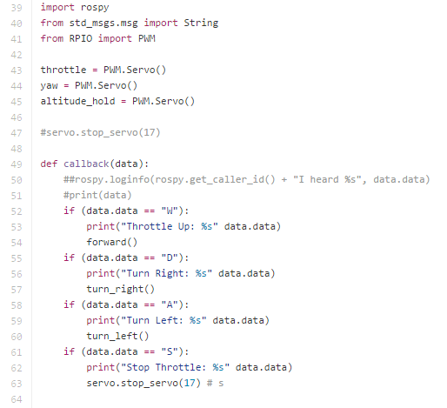
Motor Control
Enabled commands to be sent from the base computer to the motors of the UAV
Forward, turn left/right, and increase/decrease throttle
With “altitude hold”, the UAV will be ready to be flown solely from the base computer

Slide 20
Directional Commands Integration
Raspberry Pi and RC receiver => MUX
MUX => APM through input pins
APM => Pi through serial port
50 Hz, 5%-10% duty cycle (1000-2000 µs)
Roscopter cberzan pulls serial data

Slide 21
Mapping
2D Planar Mapping is working
2.5D Mapping is untested
2.5D Point Cloud Overlay on 2D grid done through costmap
A* is implementable once 2.5D mapping is tested

Slide 22
Enumeration

Slide 23
Enumeration Summary (Dayton)
Implemented people detection algorithms (MATLAB “People...”)
Implemented tracking algorithms (MATLAB “detect…”)
Organized and completed computations
Enumeration Raspberry Pi picks points
Navigation Raspberry Pi executes A star path between points
People detection on base station

Slide 24
Enumeration Summary( Dayton )
Attained Raspberry Pi Camera control, effective camera layout, and communication (python code and Wi-Fi connection to a PC)
Collected empirical data for occupant counts
Acquired sensor data for Map Decomposition
Used sensor data for Map Data
Enumeration sweep algorithm
Path instructions from Sweep algorithm

Slide 25
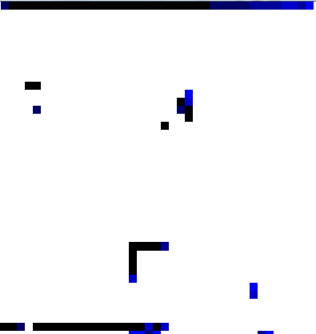
Nathan Kocmoud
Developed a C++ program that:
takes in points from the 2D scanner during the navigation phase
overlays points onto a grid of 4" x 4" cells that each store number of points inside
Filters points for errors and prepares the map
passes the simplified map and starting point to the Zhang-Suen algorithm

Slide 26
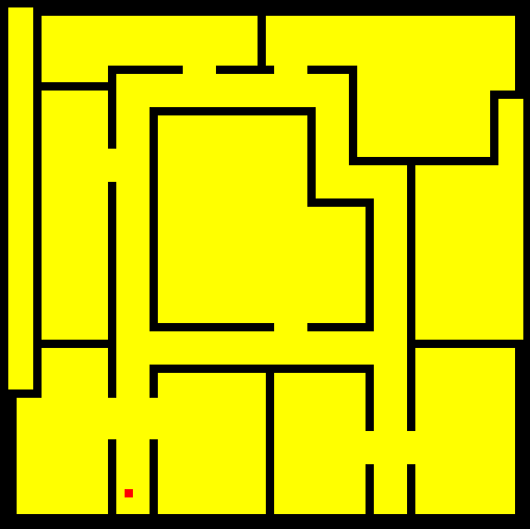
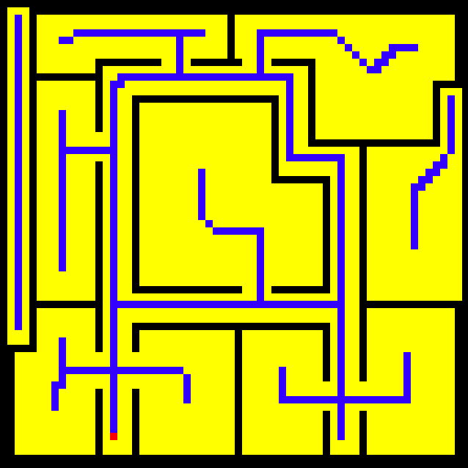
Sample map and starting point
After going through the Zhang-Suen algorithm

Slide 27
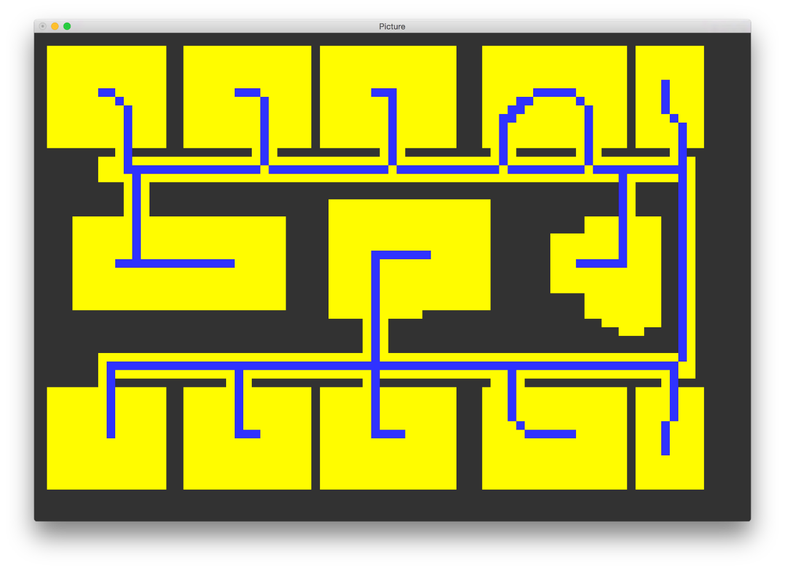
Enumeration sweep algorithm (Allison)
Zhang-Suen image decomposition algorithm
“Critical points” are spur endpoints and peaks of loop
Create path from arbitrary startpoint

Slide 28
Raspberry Pi Camera Module Operation (Allison)
Wireless stream video from the Raspberry Pi
Base computer receives the stream using a TCP/IP protocol
Managed by VLC media player
The ffmpeg library can be used to process video

Slide 29
Jui Yen "Olo" Chua
MATLAB People Detection Procedure:
i. Break input video file into video frames.
ii. Apply people identification algorithm through Computer Vision System Toolbox.
iii. Update global enumeration via comparing the counters of previous and current frames.

Slide 30
The Counting Algorithm Currently (Dayton)
Speed is faster, but not to real time yet
Image Size (Reduced to 700 wide by 500 tall)
Functions: 25% of Processing Time – “displaying tracking results”
Accuracy
Close up sparse crowds (occupant’s feet in the ROI)
Far away crowds
Unpredictable Patterns: Sitting, varying velocity, complex walking patterns

Slide 31
Updating Tracks: Adding and Deleting (Dayton and Olo )
Originally we hypothesized that the deleted tracks provided the best data for providing a people count because of track age and track certainty history.
Now, the count has proved to be more effective by taking the difference between the number of detected people in video frame and if it is a positive number a new person is detected. That detection is added to the global count.

Slide 32
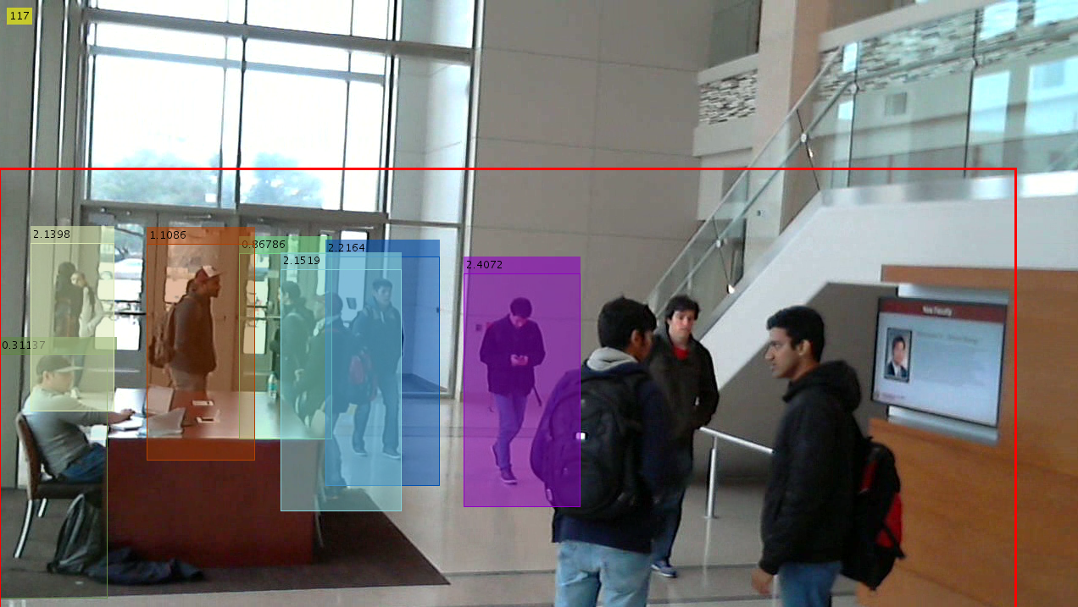
Results at ~20ft
About 7 out of 9

Slide 33
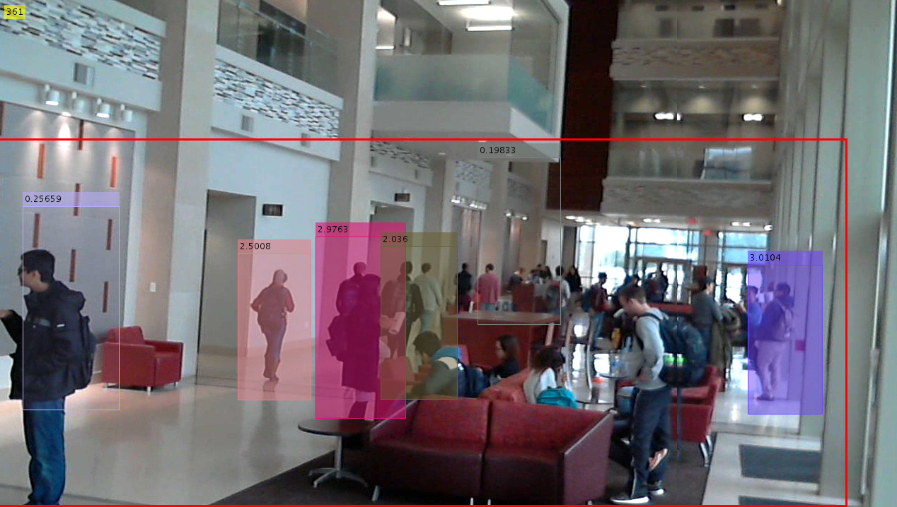
Results at ~80ft
About 6 out of 28

Slide 34
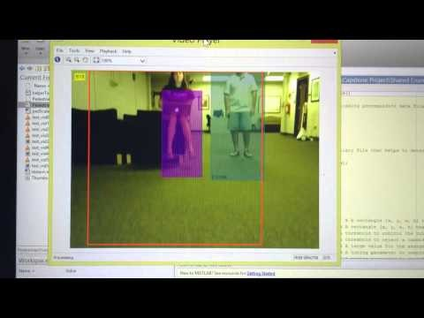
Newer Results
https://youtu.be/jk7FfYI40gU

Slide 35
Solutions to Crowds and Distance
Point the Pi camera down at an angle
Get closer for counts
New Results
UAV flight demonstrated successfully
Pi camera communication success
Stable flight footage for effective people detections
Successful processing on base computer

Slide 36
Conclusion (Dayton)
Enumeration
Successfully demonstrated people counting
Completed map creation and decomposition
Enumeration sweep algorithm should cover all territory (but still needs to be implemented autonomously)
Demonstrated effective communication between Raspberry Pi and base computer
The algorithm allows for scalability: the addition of more UAVs
The algorithm is an effective fast paced method

Slide 37
The Future of Enumeration (Dayton)
Autonomously convert Enumeration Sweep into flight instructions
Execute autonomous enumeration sweep
Gather empirical data on autonomous count
Determine sources of error
Improve on design (there's always room for improvement)

Slide 38
Team Conclusion
The team believes that autonomous control is within reach and that a little more work will prove the validity of their autonomous design

Slide 39
Flying Spring Schedule
Task Name | Duration | Start | Finish
TRL level 5 | 22 days | Fri 12/12/14 | Mon 2/28/15
Test Ardu-Copter software with autonomous control | 20 days | Tue 12/16/14 | Mon 1/12/15
Hector Mapping Using Real-Time Data | 31 days | Mon 12/1/14 | Sat 1/10/15
Have camera actively working live (Enumeration) | 32 days | Fri 1/30/15 | Sat 3/14/15
Test Ultrasonic Sensor | 30 days | Tue 1/20/15 | Sat 2/28/15
TRL level 6 | 22 days | Thu 1/15/15 | Mon 3/31/15
Integrate Ultrasonic Sensor on UAV | 30 days | Tue 1/20/15 | Sat 3/31/15
Integrate advanced grid and A* algorithms | 16 days | Tue 1/20/15 | Sat 3/31/15
2.5D Hector Mapping with IMU | 32 days | Tue 1/20/15 | Sat 3/31/15
Test Hector Mapping on UAV | 17 days | Tue 1/20/15 | Sat 3/31/15
Pair Exploration Algorithm with Ardupilot | 16 days | Mon 1/19/15 | Sat 3/31/15
Integrate Exploration Algorithm and Mapping | 12 days | Sun 2/1/15 | Sat 3/31/15
Implement Exploration on UAV and Test | 12 days | Sat 2/14/15 | Sat 3/31/15
TRL level 7 | 22 days | Fri 3/20/15 | Mon 4/21/15
Final Exploration Tests | 12 days | Sun 3/27/15 | Sat 4/14/15
Final Mapping Tests | 12 days | Sun 3/27/15 | Sat 4/14/15
Final Integrated Navigation Testing | 12 days | Sat 3/27/15 | Sat 4/21/15

Slide 40
Budget
Purchase | Quantity | Cost | Shipping |  | Total
Hyperion EOS 0606i Charger | 1 | $109.99 |  |  | $870.96
Dji F450 TOP And BOTTOM CENTRAL BOARDS | 1 | $16.00 | $6.65
apm 2.6 | 1 | $159.99 | $2.86
3DR uBlox GPS with Compass Kit and GPS mast | 1 | $97.49 | $2.32
Arduino host shield | 1 | $24.00 | $9.22
quad copter landing gear | 1 | $15.00 | $20.66
quad copter arms | 4 | $26.00
quad copter propeller guards | 1 | $19.00
1G raspberry pi 2 | 2 | $70.00 | $15.99
Raspberry Pi 8G SD card | 1 | $12.98
Raspberry Pi 16G SD card | 1 | $20.00
Raspberry Pi 32G SD card | 1 | $35.00
Pi camera | 1 | $25.00 | $5.85
Quadcopter Propeller | 2 | $60.00 | $9.90
Raspberry Pi Wireless Module | 1 | $12.95
Ultrasonic Distance Sensor | 1 | $79.90 | $14.21
Zippy Battery | 1 | $63.32
Subtotal |  | $783.30 | $87.66

Slide 41

Questions?

Slide 42
References
"Object Detection and Recognition." MathWorks.com. The MathWorks, Inc., 1 June 2005. Web. 12 Dec. 2014. <http://www.mathworks.com/help/vision/ref/vision.peopledetector-class.html>.
"Tracking Pedestrians from a Moving Car." MathWorks.com. The MathWorks, Inc., 1 June 2005. Web. 12 Dec. 2014. <http://www.mathworks.com/examples/matlab-computer-vision/754-tracking-pedestrians-from-a-moving-car>.
"Vision.CascadeObjectDetector System Object." Mathworks.com. The Mathworks, Inc., 1 June 2005. Web. 13 Dec. 2014. <http://www.mathworks.com/help/vision/ref/vision.cascadeobjectdetector-class.html>.
"Using Hector Slam with Hokuyo Laser Range Finder." - ROS Answers: Open Source Q&A Forum. N.p., n.d. Web. 04 May 2015.
Digital Accelerometer. Digital image. Parallax. N.p., n.d. Web.
Electric Propeller Motor. Digital image. Dreamstime. N.p., n.d. Web.
Multiplexer. Digital image. Alpha-Crucis. N.p., n.d. Web.
Pi Camera. Digital image. Adafruit. N.p., n.d. Web.
Raspberry Pi. Digital image. Wikimedia. N.p., n.d. Web.
RC Controller. Digital image. Aliimg. N.p., n.d. Web.
RC Reciever. Digital image. Aliimg. N.p., n.d. Web.
Samsung Laptop. Digital image. Wired. N.p., n.d. Web.
Ultrasonic Sensor. Digital image. Maxbotix. N.p., n.d. Web.
URG Sensor. Digital image. Hizook. N.p., n.d. Web.
Jones, Dave. "Picamera." Git Hub, 4 Apr. 2015. Web. 4 May 2014. <http://picamera.readthedocs.org/en/release-1.10/>.
APM 2.6. Digital image. Explore Labs. N.p., n.d. Web.
RC Reciever. Digital image. Computer Systems. N.p., n.d. Web.

Slide 43
Backup slide for Enumeration Video
https://youtu.be/N5P-BDNK3sE?t=3s

